Slide 1



Slide 2

The Impact of Migration on Housing Prices in the US
Final Project and Econometric Analysis

Slide 3
The Impact of Migration on Housing Prices in the US
Final Project and Econometric Analysis

Slide 4
TABLE OF CONTENTS
03
INTRODUCTION
04
RESEARCH QUESTIONS?
05
DATASETS
06
DATA PROCESSING
07
FINDINGS
11
ECONOMETRIC ANALYSIS
13
DISCUSSIONS
14
CONCLUSION

Slide 5
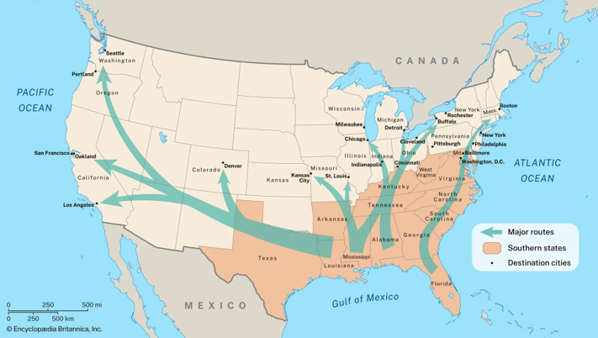

INTRODUCTION
Motivation
1
Migration is the movement of people, either domestically or abroad, for reasons including education, family reunification, economic opportunities, or fleeing war.
We aim to uncover the impact of migrants' influx (both domestic and foreign) on local home prices, taking into account the market's demand and supply aspects, such as interest rates.
2
Why It Matters
Migration's impact on housing prices aids policymakers in stabilizing the market, providing insights for homeowners and renters, and guiding urban planning and infrastructure development.

Slide 6

RESEARCH QUESTIONS
What is the relationship between migration and housing prices? (Descriptive, Predictive)
1
How does the effect on housing prices and migration vary according to counties? (Descriptive)
2
The distribution patterns of migration and housing prices across states and time? (Descriptive)
3
The impact of urbanization driven by migration on housing prices? (Descriptive)
4

Slide 7

DATA SET
Migration Data Sets
The Internal Revenue Service (IRS) provides migration data from 2013 to 2020, based on address changes on individual income tax returns. The data includes inflows and outflows, with Agi, the aggregate migration flow at the state level, reported in thousands of dollars.
Source: (https://www.irs.gov/statistics/soi-tax-stats-migration-data-2013-2020)
1
2
Housing Prices Data Set
The Federal Housing Finance Agency (FHFA) provided the housing price data set, including a uniform appraisal dataset. The data spans from 2013 to 2020, with annual housing value represented by the geoname of a county. The value is assessed by a certified appraiser.
Source: (https://www.fhfa.gov/sites/default/files/2024-09/UADAggs_county_v3_2.zip)
Prime Interest Rates
The control variable is interest rate from 2013 to 2020. The interest rates were scraped from the JP Morgan Bank website and averaged by year.
Notes:
The story of Bida, the black snake, explains the wealth of ancient Ghana. He demanded an annual sacrifice for prosperity, which involved a virgin being sacrificed. After being rescued by Madou Sarolle's fiancé, Bida took revenge, leading to a drought and decline in gold mining. Archaeological evidence supports the story, showing abundant sheep, cows, and goats until the 12th century.

Slide 8

DATA PROCESSING
Migration Data
There were no missing values. We changed the column names to make them more descriptive. We kept only county-level inflow data in the data set. Each year has its own file. Because the migration data is based on tax return filings, it may not accurately reflect the actual migration into the county, as some individuals who move in and out may not file a tax return.
2
Housing Prices Data
The Federal Housing Finance Agency suppressed some housing prices for counties with fewer than five values, but all data from purchase prices was used for housing values. The final data set included data for fifty states and the District of Columbia, subset by year, and bound into a single frame for analysis.
Notes:
Maghreb traders from North Africa began their journey to Ghana, passing through Tahert, Sjilmasa, Awdaghust, and eventually reaching Kumbi Saleh, the royal town of Ancient Ghana.

Slide 9
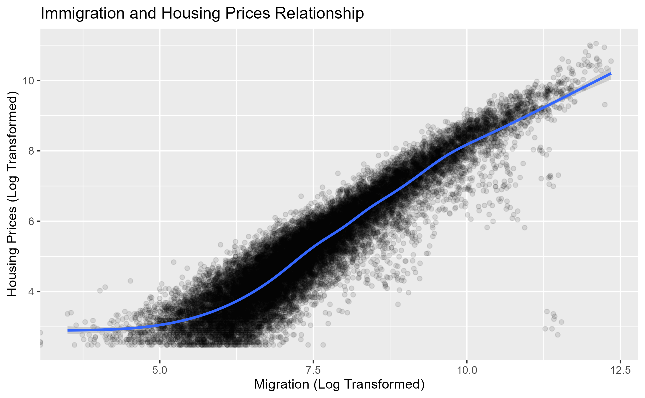
ANSWERS TO RESEARCH QUESTIONS
Finding 1: The relationship between migration and housing prices
There is a clear positive non-linear relationship (upward-sloping pattern) between migration and housing prices. This indicates that as the number of migrants increases, housing prices also tend to increase. The points are tightly clustered around a linear trend suggesting a high correlation.
Notes:
Ghana's decline was attributed to factors such as losing the King's trading monopoly, drought, and Almoravid Muslim invasion. New gold fields in Bure and trade routes opened, leading to attacks by Sosso ruler Sumanguru. In 1235, the Malinke people under Sundiata Keita and emerged, and the Mali Empire of Sundiata eventually surpassed Ghana.

Slide 10
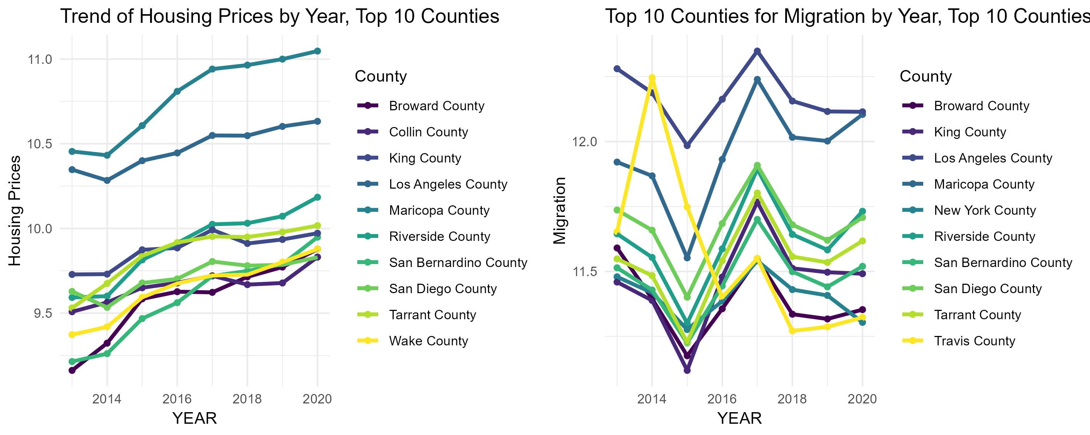
ANSWERS TO RESEARCH QUESTIONS
Finding 2: How does the effect on housing prices and migration vary according to counties? (Descriptive)
Housing Price Trends
Migration Inflow
• All counties experienced significant and consistent increases in housing prices, with Maricopa and Los Angeles experiencing the highest level of housing prices.
•Other counties such as San Bernardino, Tarrant, and Wake show steady growth. These areas likely represent the suburban areas of larger cities and thus offer relatively more affordable housing without losing the benefits of proximity to the city center.
• Migration flow follows a similar pattern as observed in the graph above, steadily declining in 2013 hitting its lowest peak in 2015, and rising sharply again hitting its highest peak in 2017. But Travis County showed otherwise, it increased and decreased consistently.
. Los Angeles County consistently has the highest migration inflow, but it declines over time.
• Maricopa and Riverside show gradual increases and stable trends toward 2020.
Notes:
Ghana's decline was attributed to factors such as losing the King's trading monopoly, drought, and Almoravid Muslim invasion. New gold fields in Bure and trade routes opened, leading to attacks by Sosso ruler Sumanguru. In 1235, the Malinke people under Sundiata Keita and emerged, and the Mali Empire of Sundiata eventually surpassed Ghana.

Slide 11
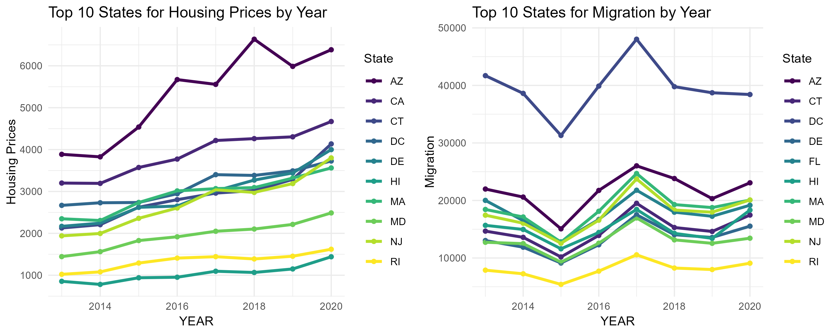
ANSWERS TO RESEARCH QUESTIONS
Finding 3: The distribution patterns of migration and housing prices across states and time. (Descriptive)
From the graph above, the migration flow of states follows similar patterns. It was fairly stable in 2014, decreasing and peaking up again in 2017 with Arizona (AZ) and the District of Columbia (DC) showing consistently high migration levels, peaking around 2017 before declining. Migration trends might be influenced by affordability, job opportunities, and quality of life. Arizona (AZ) and California (CA) experiencing the highest rise in housing prices. While the rest of the states show slower growth. Housing prices stabilized in 2014, declined in 2015, and rose again in 2018.
As expected, in 2014, as migration fairly declined, housing prices were stable if not declining. In 2015, as it began to rise, peaking around 2017 and declining, house prices around that period also began to rise, peaking in 2018 and fairly stabilizing.
Notes:
Ghana's decline was attributed to factors such as losing the King's trading monopoly, drought, and Almoravid Muslim invasion. New gold fields in Bure and trade routes opened, leading to attacks by Sosso ruler Sumanguru. In 1235, the Malinke people under Sundiata Keita and emerged, and the Mali Empire of Sundiata eventually surpassed Ghana.

Slide 12
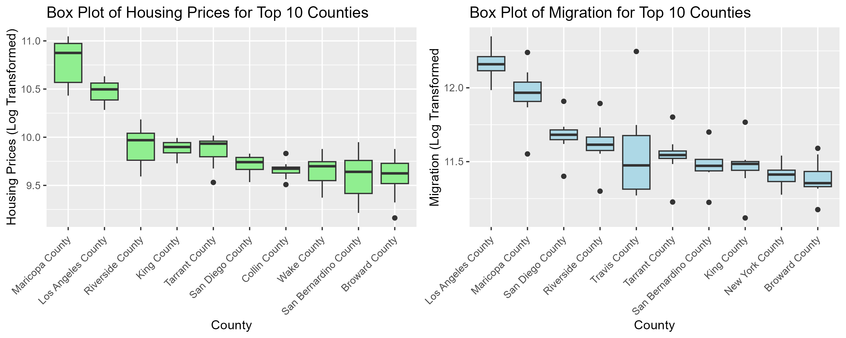
ANSWERS TO RESEARCH QUESTIONS
Finding 4: Impact of urbanization on migration and housing prices
The two diagrams highlight key factors in urbanization, which is brought about by the relationship between migration and housing prices. As was shown for Maricopa and Riverside Counties, rapid population inflow means a greater demand for housing and increased prices.
This shows how economic opportunities are concentrated in urban areas. On the other hand, counties may experience high housing prices as a result of the spillover effect of urbanization. These areas likely represent the suburban areas of larger cities and thus offer relatively more affordable housing without losing the benefits of proximity to the city center.
Notes:
Ghana's decline was attributed to factors such as losing the King's trading monopoly, drought, and Almoravid Muslim invasion. New gold fields in Bure and trade routes opened, leading to attacks by Sosso ruler Sumanguru. In 1235, the Malinke people under Sundiata Keita and emerged, and the Mali Empire of Sundiata eventually surpassed Ghana.

Slide 13
ECONOMETRIC ANALYSIS
Motivation
1
The study conducted a regression analysis to provide a quantitative perspective on the relationship between housing price and migration but cannot claim causal inference due to a lack of clear counterfactuals.
2
Why It Matters
The study utilized a linear fixed effects model to estimate the impact of migration on housing prices, accounting for average prime rates as a control variable.

Slide 14
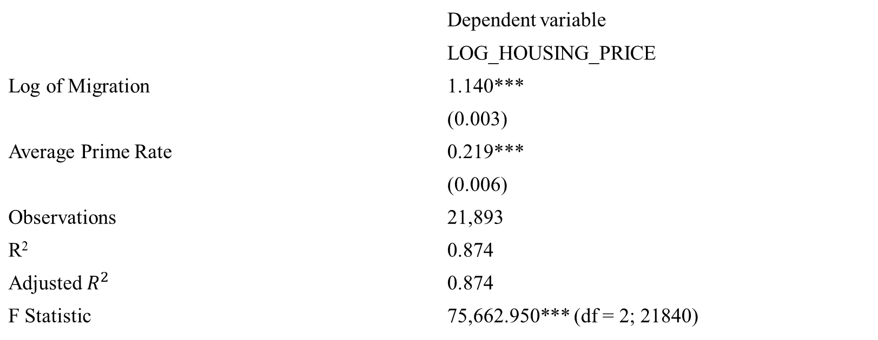
RESULTS
Regression Output
 | Dependent variable
 | LOG_HOUSING_PRICE
Log of Migration | 1.140***
 | (0.003)
Average Prime Rate | 0.219***
 | (0.006)
Observations | 21,893
R² | 0.874
Adjusted $R^{2}$ | 0.874
F Statistic | 75,662.950*** (df = 2; 21840)
Note: p<0.1; p<0.05; p<0.01
Notes:
By the end of the 16th century, most ethnic groups constituting the modern Ghanaian population had settled in their present locations. These migrations were partly influenced by the formation and disintegration of large states in the western Sudan, including the Soninke Kingdom of Ancient Ghana. its legacy endured, inspiring the naming of modern Ghana upon independence in 1957.

Slide 15
DISCUSSION
Interpretation
The study reveals a significant correlation between migration and housing prices, with a 1% increase in migration resulting in a 1.14 percent increase in housing prices. Additionally, a unit increase in the average prime rate is associated with a 22% increase in housing prices, indicating a strong correlation.
1
2
Limitations
The data analysis has limitations, including omission variable bias, inability to account for unmeasured factors like income and employment rates, inability to prove that migration and prime rates cause housing prices, and the fixed effects model not accounting for time-varying factors unique to individual states.
Notes:
The story of Bida, the black snake, explains the wealth of ancient Ghana. He demanded an annual sacrifice for prosperity, which involved a virgin being sacrificed. After being rescued by Madou Sarolle's fiancé, Bida took revenge, leading to a drought and decline in gold mining. Archaeological evidence supports the story, showing abundant sheep, cows, and goats until the 12th century.

Slide 16
OUTRO
Conclusion
1
Housing demand increases due to the influx of individuals, economic growth, migration, and higher prime rates. Economic growth and migration can intensify demand, potentially leading to gentrification. Rising prime rates can signal tighter monetary policies, causing temporary spikes in housing prices as buyers secure loans before rates climb further.
2
Policy Implications
To combat rising housing prices driven by migration, local governments should focus on affordable housing, rezoning, and improving infrastructure. Low-interest loans and stricter lending standards can also help manage rising prime rates.

Slide 17


